Slide 1
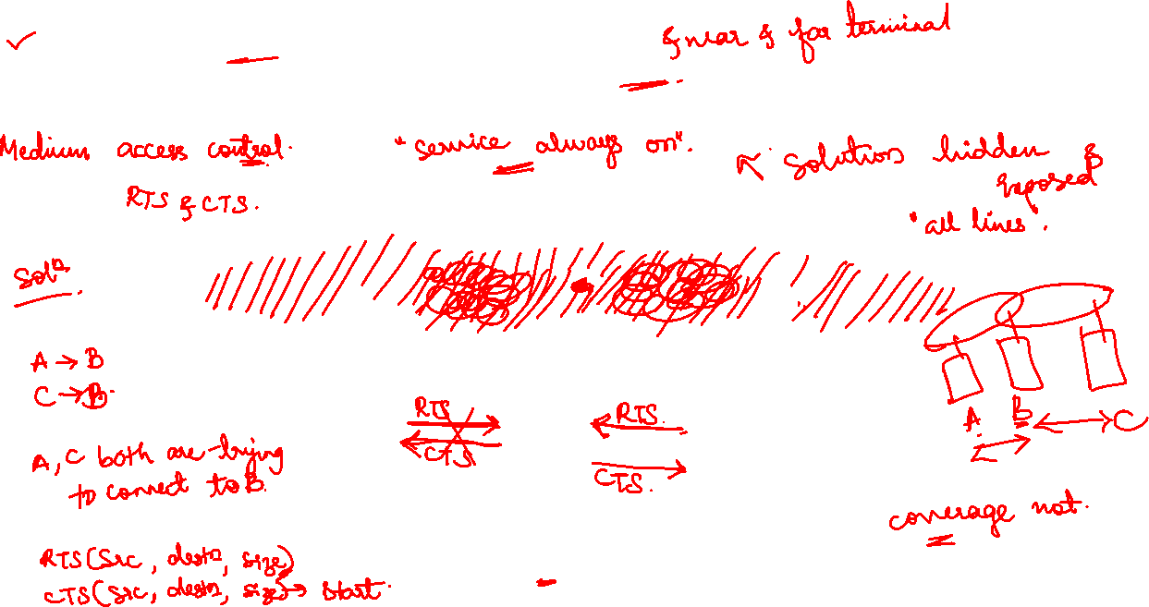
Hidden and Exposed Terminal Problem

Slide 2
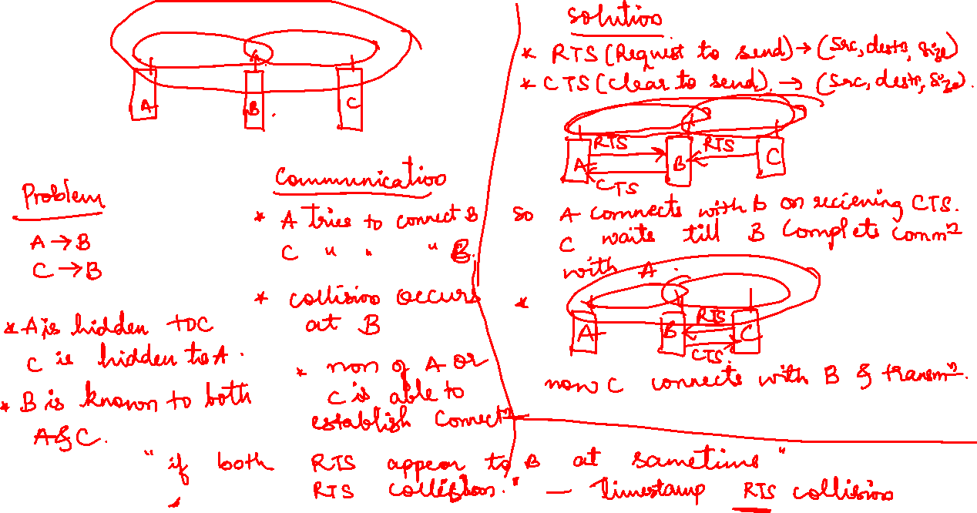

Slide 3
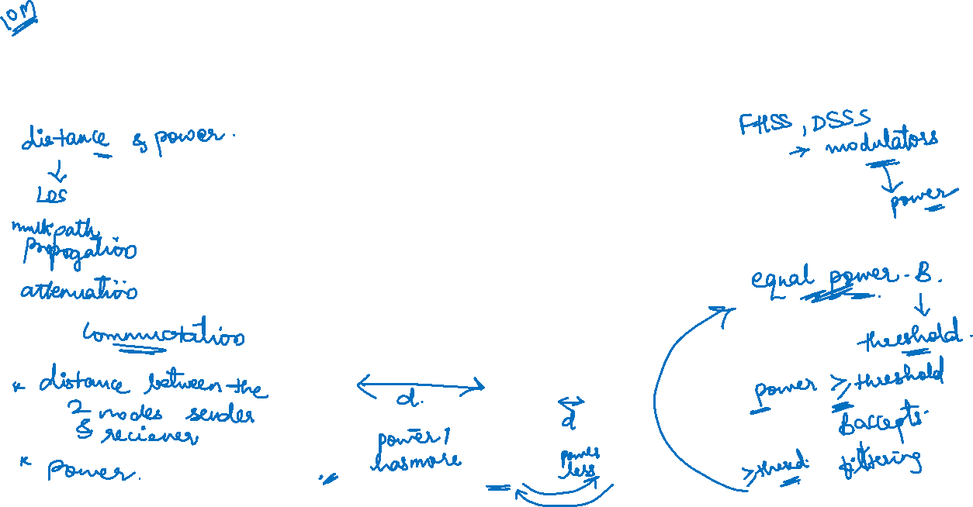
Near and far terminal problem-a person standing closer to somebody could always speak louder than a person further away

Slide 4
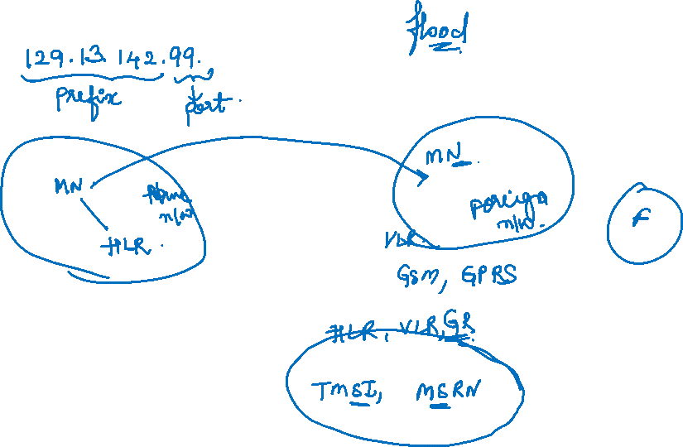
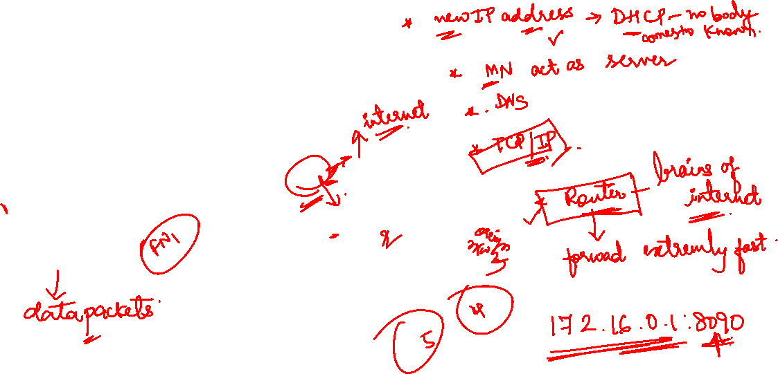
Mobile IP

Slide 5
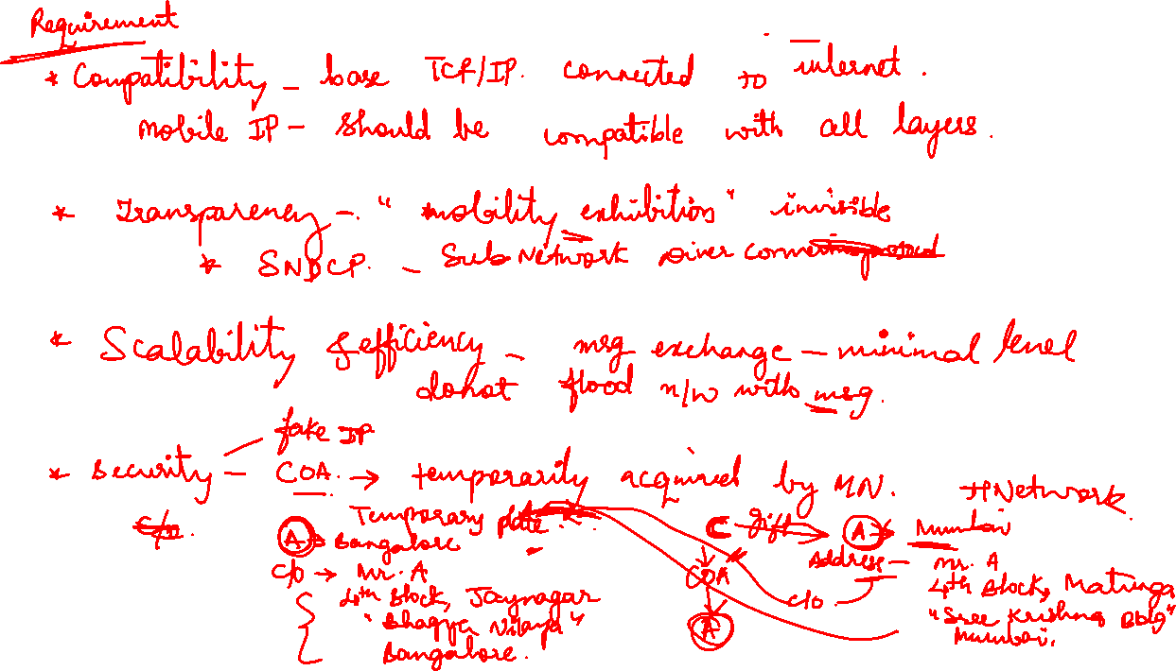

Slide 6
Motivation for Mobile IP
Routing
based on IP destination address, network prefix (e.g. 129.13.42) determines physical subnet
change of physical subnet implies change of IP address to have a topological correct address (standard IP) or needs special entries in the routing tables
Specific routes to end-systems?
change of all routing table entries to forward packets to the right destination
does not scale with the number of mobile hosts and frequent changes in the location, security problems
Changing the IP-address?
adjust the host IP address depending on the current location
almost impossible to find a mobile system, DNS updates take to long time
TCP connections break, security problems

Slide 7
Requirements to Mobile IP
Transparency
mobile end-systems keep their IP address
continuation of communication after interruption of link possible
point of connection to the fixed network can be changed
Compatibility
support of the same layer 2 protocols as IP
no changes to current end-systems and routers required
mobile end-systems can communicate with fixed systems
Security
authentication of all registration messages
Efficiency and scalability
only little additional messages to the mobile system required (connection typically via a low bandwidth radio link)
world-wide support of a large number of mobile systems in the whole Internet

Slide 8
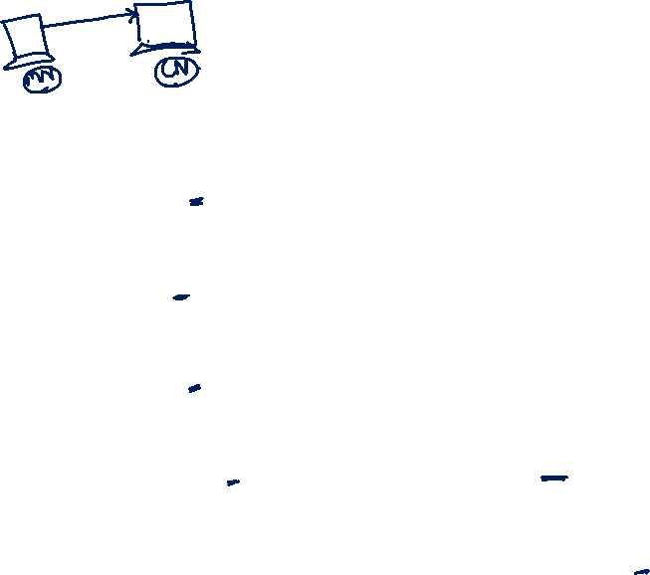
Terminology
Mobile Node (MN)
system (node) that can change the point of connection to the network without changing its IP address
Home Agent (HA)
system in the home network of the MN, typically a router
registers the location of the MN, tunnels IP datagrams to the COA
Foreign Agent (FA)
system in the current foreign network of the MN, typically a router
forwards the tunneled datagrams to the MN, typically also the default router for the MN
Care-of Address (COA)
address of the current tunnel end-point for the MN (at FA or MN)
actual location of the MN from an IP point of view
can be chosen, e.g., via DHCP
Correspondent Node (CN)
communication partner

Slide 9

Example network
HA
MN
Internet
router
home network
mobile end-system
(physical home network
for the MN)
FA
foreign network
router
(current physical network for the MN)
CN
end-system
router

Slide 10
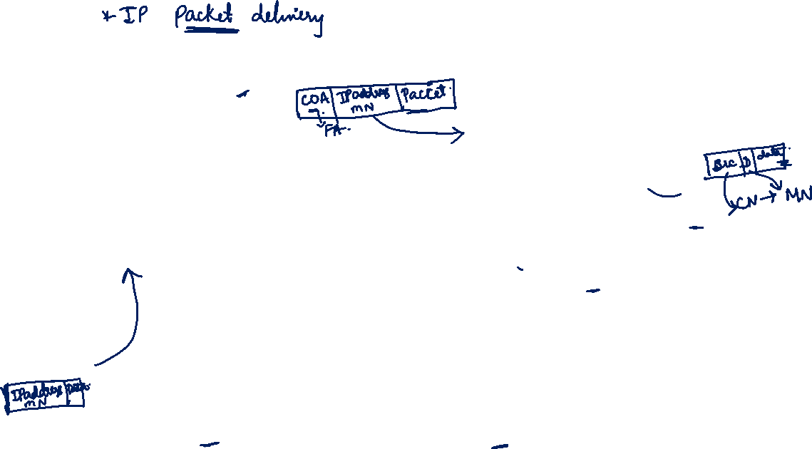
Data transfer to the mobile system
HA
2
MN
Internet
home network
3
receiver
FA
foreign
network
1. Sender sends to the IP address of MN,
HA intercepts packet (proxy ARP)
2. HA tunnels packet to COA, here FA,
by encapsulation
3. FA forwards the packet to the MN
1
CN
sender

Slide 11
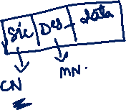
Data transfer from the mobile system
HA
1
MN
Internet
home network
sender
FA
foreign network
1. Sender sends to the IP address of the receiver as usual, FA works as default router
CN
receiver

Slide 12

Overview
COA
foreign
network
home
network
router
HA
router
FA
MN
Internet
CN
router
3.
foreign
network
home
network
router
HA
router
FA
MN
2.
4.
Internet
1.
CN
router

Slide 13


Network integration
Agent Advertisement
HA and FA periodically send advertisement messages into their physical subnets
MN listens to these messages and detects, if it is in the home or a foreign network (standard case for home network)
MN reads a COA from the FA advertisement messages
Registration (always limited lifetime!)
MN signals COA to the HA via the FA, HA acknowledges via FA to MN
these actions have to be secured by authentication
Advertisement
HA advertises the IP address of the MN (as for fixed systems), i.e. standard routing information
routers adjust their entries, these are stable for a longer time (HA responsible for a MN over a longer period of time)
packets to the MN are sent to the HA,
independent of changes in COA/FA

Slide 14
Agent advertisement
0
7
8
15
16
23
24
31
type
code
checksum
#addresses
addr. size
lifetime
router address 1
preference level 1
router address 2
preference level 2
. . .
type = 16
length = 6 + 4 * #COAs
R: registration required
B: busy, no more registrations
H: home agent
F: foreign agent
M: minimal encapsulation
G: GRE encapsulation
r: =0, ignored (former Van Jacobson compression)
T: FA supports reverse tunneling
reserved: =0, ignored
type = 16
length
sequence number
registration lifetime
R
B
H
F
M
G
r
T
reserved
COA 1
COA 2
. . .

Slide 15
Agent Solicitation
If no agent advertisements are present or the inter-arrival time is too high, and an MN has not received a COA by other means, e.g., DHCP , the mobile node must send agent solicitations.
Care must be taken to ensure that these solicitation messages do not flood the network, but basically an MN can search for an FA endlessly sending out solicitation messages.
Typically, a mobile node can send out three solicitations, one per second, as soon as it enters a new network.
If a node does not receive an answer to its solicitations it must decrease the rate of solicitations exponentially to avoid flooding the network until it reaches a maximum interval between solicitations (typically one minute).
After these steps of advertisements or solicitations the MN can now receive a COA, either one for an FA or a co-located COA.
After these steps of advertisements or solicitations the MN can now receive a COA, either one for an FA or a co-located COA. The MN knows its location (home network or foreign network) and the capabilities of the agent (if needed).
The next step for the MN is the registration with the HA if the MN is in a foreign network.

Slide 16
Registration-Having received a COA, the MN has to register with the HA. The main purpose of the registration is to inform the HA of the current location for correct forwarding of packets. Registration can be done in two different ways depending on the location of the COA.
MN
FA
HA
MN
HA
registration
request
registration
request
registration
request
registration
reply
registration
reply
t
registration
reply
t
The HA now sets up a mobility binding containing the mobile node’s home IP address and the current COA. Additionally, the mobility binding contains the lifetime of the registration. Registration expires automatically after the lifetime and is deleted; so, an MN should reregister before expiration.
If the COA is co-located, registration can be simpler. if the MN received an agent advertisement from the FA it should register via this FA if the R bit is set in the advertisement.

Slide 17
Mobile IP registration request
The first field type is set to 1 for a registration request.
0
7
8
15
16
23
24
31
type = 1
S
B
D
M
G
r
T x
lifetime
home address
home agent
COA
identification
extensions . . .

Slide 18
Mobile IP registration request
The first field type is set to 1 for a registration request.
0
7
8
15
16
23
24
31
UDP packets are used for registration requests. The IP source address of the packet is set to the interface address of the MN, the IP destination address is that of the FA or HA (depending on the location of the COA).
UDP is used because of low overheads and better performance
compared to TCP in wireless environments.
type = 1
S
B
D
M
G
r
T x
lifetime
home address
home agent
COA
identification
extensions . . .
S: simultaneous bindings-MN can specify if it wants the HA to retain prior mobility bindings.
B: broadcast datagrams-denote the requested behavior for packet forwarding. Setting the B bit generally indicates that an MN also wants to receive the broadcast packets which have been received by the HA in the home network.
D: decapsulation by MN -If an MN uses a co-located COA, it also takes care of the decapsulation at the tunnel endpoint.
M mininal encapsulation
G: GRE encapsulation
r: =0, ignored
T: reverse tunneling requested
x: =0, ignored
8.18

Slide 19
Mobile IP registration reply
0
7
8
15
16
31
type = 3
code
lifetime
home address
home agent
identification
extensions . . .
Example codes:
registration successful
0 registration accepted
1 registration accepted, but simultaneous mobility bindings unsupported
65 administratively prohibited
66 insufficient resources
67 mobile node failed authentication
68 home agent failed authentication
69 requested Lifetime too long
registration denied by HA
129 administratively prohibited
131 mobile node failed authentication
133 registration Identification mismatch
135 too many simultaneous mobility bindings

Slide 20
Mobile IP registration reply
0
7
8
15
16
31
type = 3
code
lifetime
A registration reply, which is conveyed in a UDP packet, contains a type field set to 3 and a code indicating the result of the registration request.
home address
home agent
identification
extensions . . .
Example codes:
registration successful
0 registration accepted
1 registration accepted, but simultaneous mobility bindings unsupported
65 administratively prohibited
66 insufficient resources
67 mobile node failed authentication
68 home agent failed authentication
69 requested Lifetime too long
registration denied by HA
129 administratively prohibited
131 mobile node failed authentication
133 registration Identification mismatch
135 too many simultaneous mobility bindings
The home address is the
fixed IP address of the MN, home agent is the IP address of the HA, and COA
represents the tunnel endpoint. The 64 bit identification is generated by the MN to identify a request and match it with registration replies. This field is used
for protection against replay attacks of registrations. The extensions must at
least contain parameters for authentication.
8.20

Slide 21
Encapsulation
Describes the mechanisms used for forwarding packets between the HA and the COA.
A tunnel establishes a virtual pipe for data packets between a tunnel entry and a tunnel endpoint. Packets entering a tunnel are forwarded inside the tunnel and leave the tunnel unchanged. Tunneling, i.e., sending a packet through a tunnel, is achieved by using encapsulation.
Encapsulation is the mechanism of taking a packet consisting of packet header and data and putting it into the data part of a new packet. The reverse operation, taking a packet out of the data part of another packet, is called decapsulation.

Slide 22
Encapsulation- describes exactly what the HA at the tunnel entry does. The HA takes the original packet with the MN as destination, puts it into the data part of a new packet and sets the new IP header in such a way that the packet is routed to the COA. The new header is also called the outer header for obvious reasons. Additionally, there is an inner header which can be identical to the original header as this is the case for IP-in-IP encapsulation, or the inner header can be computed during encapsulation.
original IP header
original data
new IP header
new data
outer header
inner header
original data
IP-in-IP encapsulation

Slide 23
Encapsulation I
ver.
IHL
DS (TOS)
length
IP identification
flags
fragment offset
TTL
IP-in-IP
IP checksum
IP-in-IP-encapsulation
tunnel between HA and COA
The version field ver is 4 for IP version 4,
the internet header length (IHL) denotes the length of the outer header in 32 bit words.
DS(TOS) is just copied from the inner header
the length field covers the complete encapsulated packet. The fields up to TTL are set according to RFC 791 for mobile IP.
TTL must be high enough so the packet can reach the tunnel endpoint.
IP-in-IP, is the type of the protocol used in the IP payload. This
field is set to 4, the protocol type for IPv4 because again an IPv4 packet follows after this outer header.
IP checksum is calculated as usual. The next fields are
the tunnel entry as source address (the IP address of the HA) and the tunnel exit point as destination address (the COA).
IP address of HA
Care-of address COA
ver.
IHL
DS (TOS)
length
IP identification
flags
fragment offset
TTL
lay. 4 prot.
IP checksum
IP address of CN
IP address of MN
TCP/UDP/ ... payload

Slide 24
Encapsulation II
Minimal encapsulation (optional)
avoids repetition of identical fields
e.g. TTL, IHL, version, DS (RFC 2474, old: TOS)
only applicable for unfragmented packets, no space left for fragment identification
If the S bit is set, the original sender address of the CN is included as omitting the source is quite often not an option.
ver.
IHL
DS (TOS)
length
IP identification
flags
fragment offset
TTL
min. encap.
IP checksum
IP address of HA
care-of address COA
lay. 4 protoc.
S
reserved
IP checksum
IP address of MN
original sender IP address (if S=1)
TCP/UDP/ ... payload

Slide 25
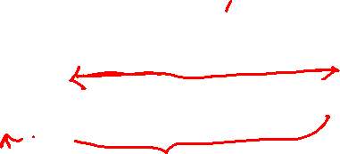
Generic routing encapsulation (GRE)
Allows the encapsulation of packets of one protocol suite into the payload portion of a packet of another
protocol suite.
the left side the fields of a packet inside the tunnel between home agent and COA using GRE as an encapsulation scheme. The outer header is the standard IP header with HA as source address and COA as destination address.
original
header
original data
outer header
GRE header
original header
original data
new header
new data

Slide 26
Generic Routing Encapsulation
RFC 1701
The protocol type used in this outer IP header is 47 for GRE.
The C bit indicates if the checksum field is present and contains valid information. If C is set, the checksum field contains a valid IP checksum of the GRE header and the payload.
The R bit indicates if the offset and routing fields are present and contain valid information.
The offset represents the offset in bytes for the first source
routing entry. The routing field, if present, has a variable length and contains fields for source routing. If the C bit is set, the offset field is also present and, vice versa, if the R bit is set, the checksum field must be present. The only reason for this is to align the following fields to 4 bytes. The checksum field is valid only if C is set, and the offset field is valid only if R is set respectively.
GRE also offers a key field which may be used for authentication. If this field is present, the K bit is set. However, the authentication algorithms are not further specified by GRE.
The sequence number bit S indicates if the sequence number field is present,
if the s bit is set, strict source routing is used.
The recursion control field (rec.) is an important field that additionally distinguishes GRE from IP-in-IP and minimal encapsulation. This field represents a counter that shows the number of allowed recursive encapsulations. As soon as a packet arrives at an encapsulator it checks whether this field equals zero. If the
field is not zero, additional encapsulation is allowed – the packet is encapsulated and the field decremented by one. Otherwise the packet will most likely be discarded. This mechanism prevents indefinite recursive encapsulation which might happen with the other schemes if tunnels are set up improperly (e.g., several
tunnels forming a loop). The default value of this field should be 0, thus allowing only one level of encapsulation.
The following reserved fields must be zero and are ignored on reception. The version field contains 0 for the GRE version.
ver.
IHL
DS (TOS)
length
IP identification
flags
fragment offset
TTL
GRE
IP checksum
IP address of HA
Care-of address COA
C
R
K
S
s
rec.
rsv.
ver.
protocol
checksum (optional)
offset (optional)
key (optional)
sequence number (optional)
routing (optional)
ver.
IHL
DS (TOS)
length
IP identification
flags
fragment offset
TTL
lay. 4 prot.
IP checksum
IP address of CN
IP address of MN
TCP/UDP/ ... payload
C
reserved0
ver.
protocol
checksum (optional)
reserved1 (=0)
RFC 2784

Slide 27

Optimization of packet forwarding
Although the computers might be only meters away, the packets have to travel around the world! This inefficient behavior of a nonoptimized mobile IP is called triangular routing. The triangle is made of the three segments, CN to HA, HA to COA/MN, and MN back to CN.
Triangular Routing
sender sends all packets via HA to MN
higher latency and network load
“Solutions”
sender learns the current location of MN
direct tunneling to this location
HA informs a sender about the location of MN
big security problems!
Change of FA
packets on-the-fly during the change can be lost
new FA informs old FA to avoid packet loss, old FA now forwards remaining packets to new FA
this information also enables the old FA to release resources for the MN

Slide 28
One way to optimize the route is to inform the CN of the current location of the MN. The CN can learn the location by caching it in a binding cache which is a part of the local routing table for the CN. The appropriate entity to inform the CN of the location is the HA. The optimized mobile IP protocol needs four additional messages.
● Binding request: Any node that wants to know the current location of an MN can send a binding request to the HA. The HA can check if the MN has allowed dissemination of its current location. If the HA is allowed to reveal the location it sends back a binding update.
● Binding update: This message sent by the HA to CNs reveals the current location of an MN. The message contains the fixed IP address of the MN and the COA. The binding update can request an acknowledgement.
● Binding acknowledgement: If requested, a node returns this acknowledgement after receiving a binding update message.
● Binding warning: If a node decapsulates a packet for an MN, but it is not the current FA for this MN, this node sends a binding warning. The warning contains MN’s home address and a target node address, i.e., the address of the node that has tried to send the packet to this MN. The recipient of the warning then knows that the target node could benefit from obtaining a fresh binding for the MN. The recipient can be the HA, so the HA should now send a binding update to the node that obviously has a wrong COA for the MN.

Slide 29
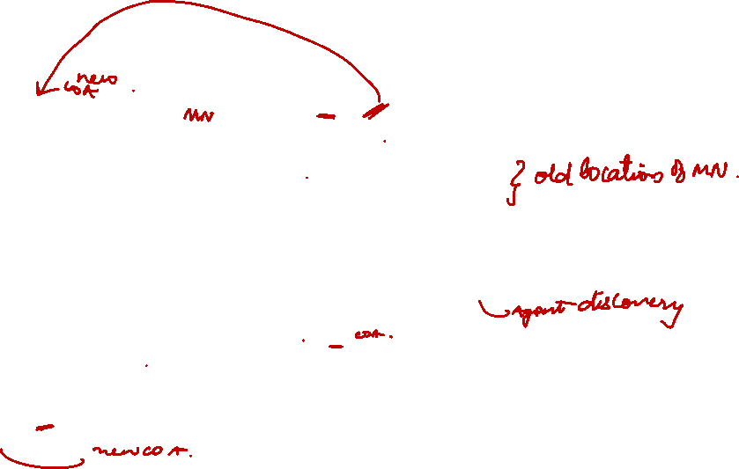
Change of foreign agent
CN
HA
FA_{old}
FA_{new}
MN
Data
Data
Data
Update
ACK
Data
Data
MN changes location
Update
Registration
ACK
Data
Data
Data
Warning
Request
Update
ACK
Data
Data
t

Slide 30
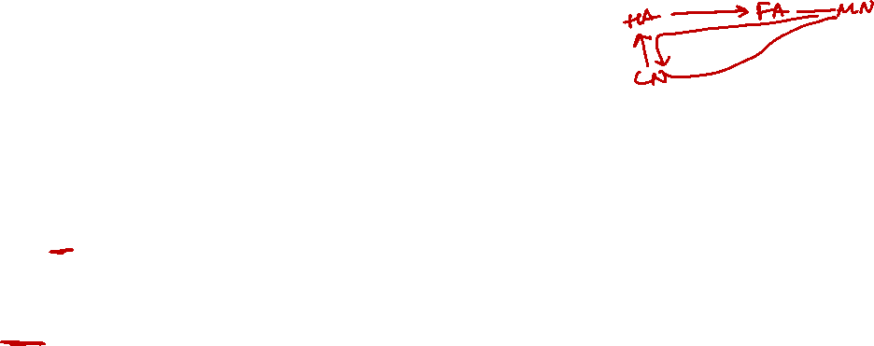
Mobile IP with reverse tunneling
Router accept often only “topological correct“ addresses (firewall!)
a packet from the MN encapsulated by the FA is now topological correct
furthermore multicast and TTL problems solved (TTL in the home network correct, but MN is to far away from the receiver)
Reverse tunneling does not solve
problems with firewalls, the reverse tunnel can be abused to circumvent security mechanisms (tunnel hijacking)
optimization of data paths, i.e. packets will be forwarded through the tunnel via the HA to a sender (double triangular routing)
The standard is backwards compatible
the extensions can be implemented easily and cooperate with current implementations without these extensions
Agent Advertisements can carry requests for reverse tunneling

Slide 31
Reverse tunneling (RFC 3024, was: 2344)
HA
2
MN
Internet
home network
1
sender
FA
foreign network
1. MN sends to FA
2. FA tunnels packets to HA
by encapsulation
3. HA forwards the packet to the
receiver (standard case)
3
CN
receiver

Slide 32
Problems with mobile IP
Security
authentication with FA problematic, for the FA typically belongs to another organization
no protocol for key management and key distribution has been standardized in the Internet
patent and export restrictions
Firewalls
typically mobile IP cannot be used together with firewalls, special set-ups are needed (such as reverse tunneling)
QoS
many new reservations in case of RSVP
tunneling makes it hard to give a flow of packets a special treatment needed for the QoS
Security, firewalls, QoS etc. are topics of current research and discussions!

Slide 33
Traditional TCP
Congestion
Congestion Control- slow start, fast retransmit/recovery
Slow start- exponential growth, linear at later stage.
Fast retransmission- retransmission due to congestion / transmission error. sender can now retransmit the missing packet(s) before the timer expires.
Reciept of ack confirms no congestions and no need of slow start its called fast recovery from packet loss.

Slide 34
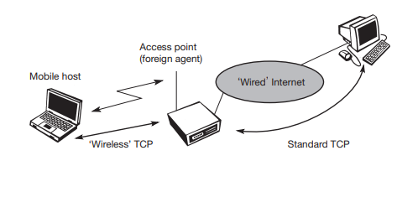
Classical TCP Improvements Indirect TCP

Slide 35
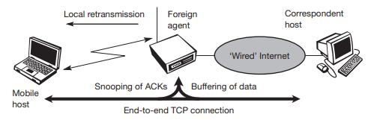
Snooping TCP

Slide 36
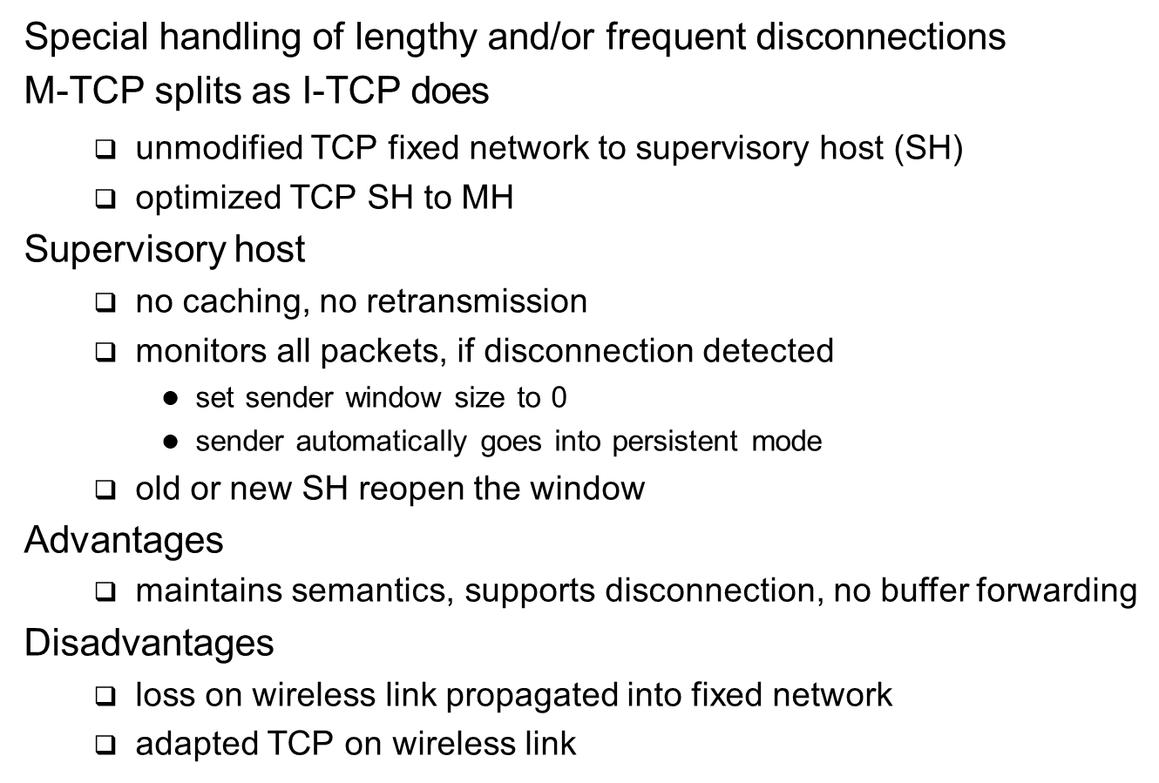
Mobile TCP

Slide 37
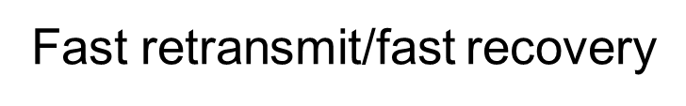
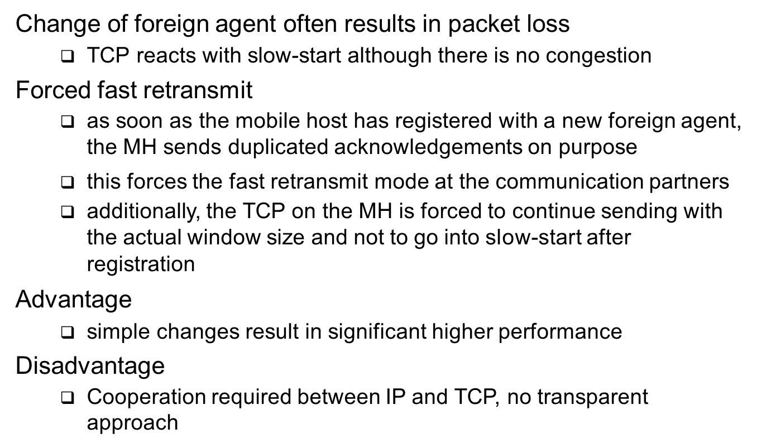

Slide 38
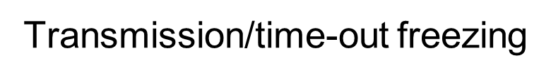
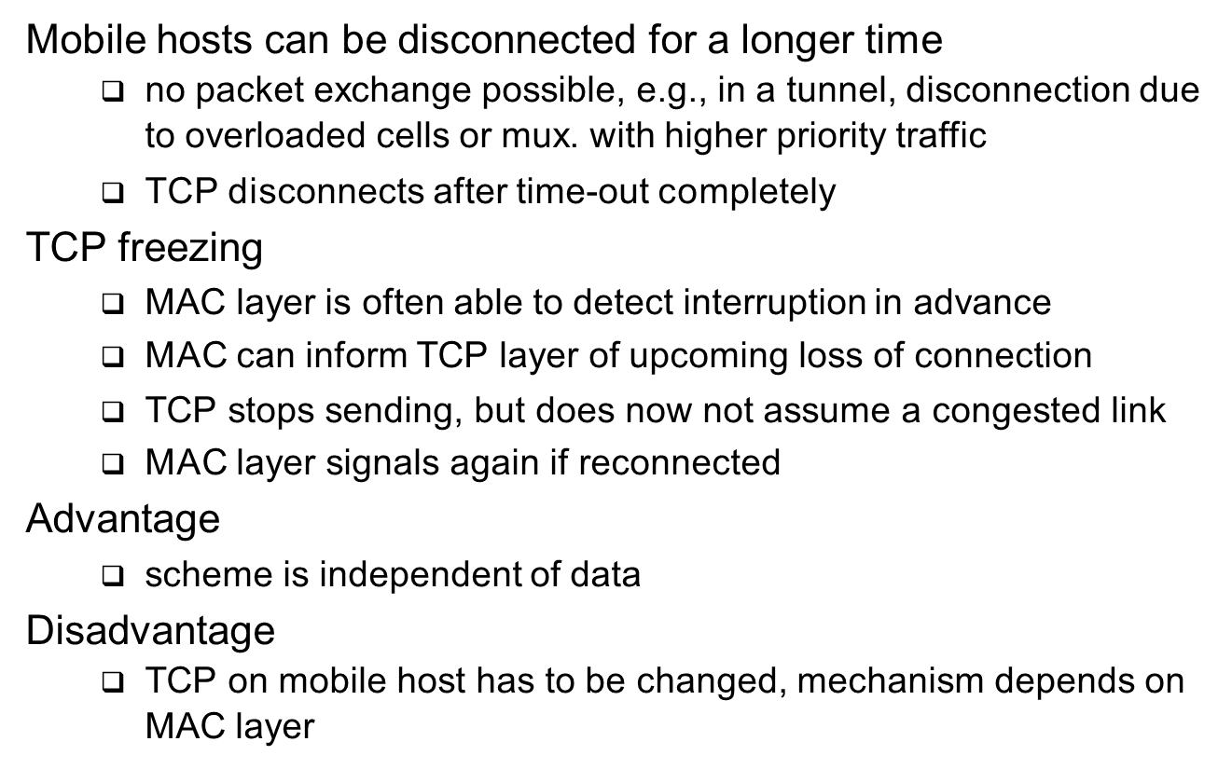

Slide 39
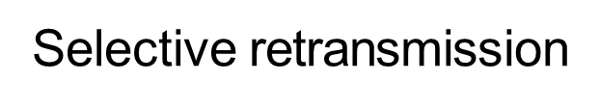
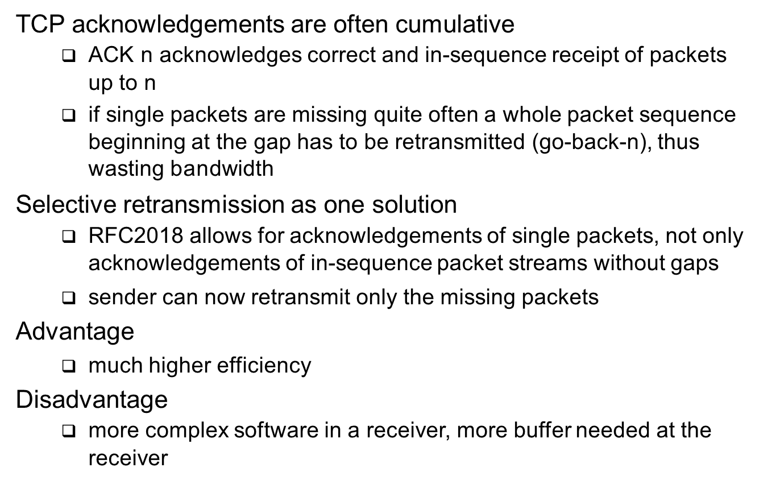

Slide 40
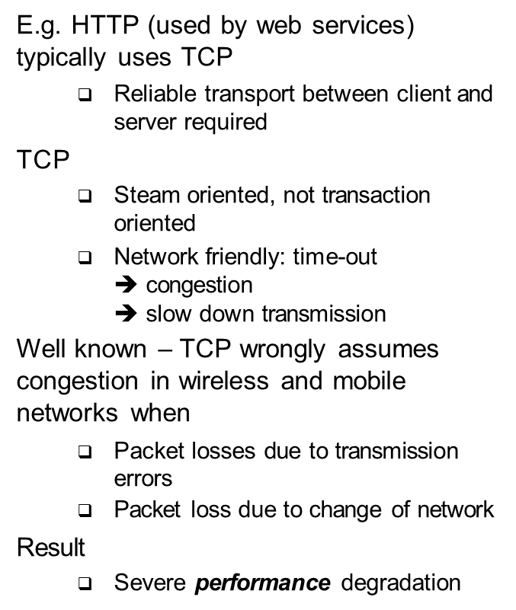
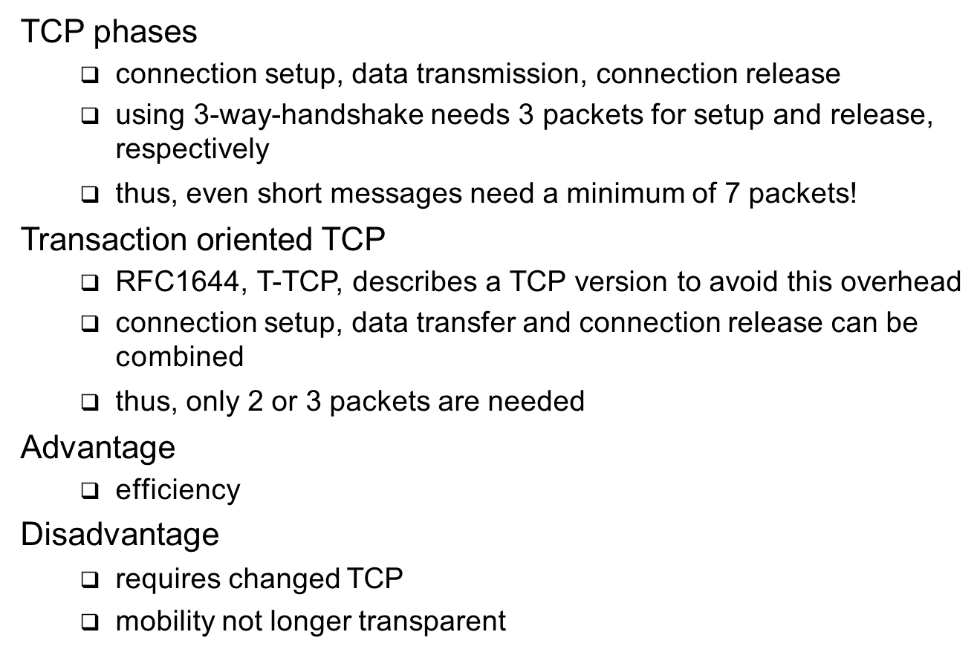
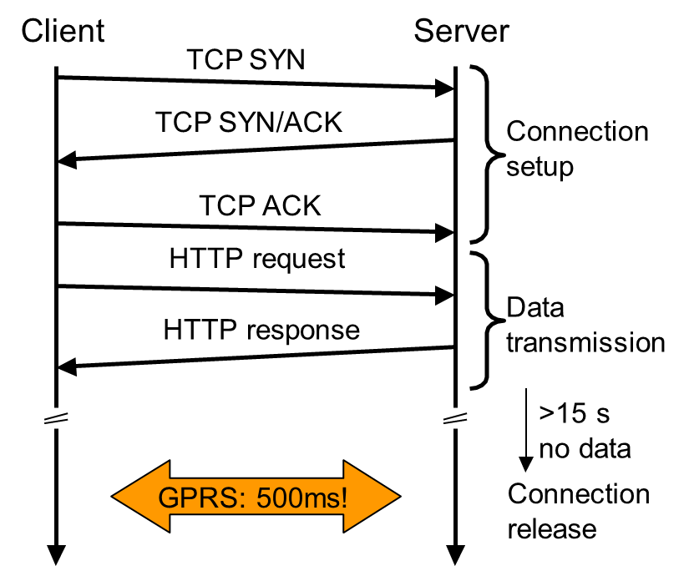
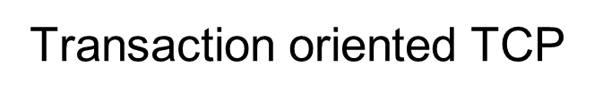

Slide 41
Approach | Mechanism | Advantages | Disadvantages
Indirect TCP | splits TCP connection into two connections | isolation of wireless link, simple | loss of TCP semantics, higher latency at handover
Snooping TCP | “snoops” data and acknowledgements, local retransmission | transparent for end-to- end connection, MAC integration possible | problematic with encryption, bad isolation of wireless link
M-TCP | splits TCP connection, chokes sender via window size | Maintains end-to-end semantics, handles long term and frequent disconnections | Bad isolation of wireless link, processing overhead due to bandwidth management
Fast retransmit/ fast recovery | avoids slow-start after roaming | simple and efficient | mixed layers, not transparent
Transmission/ time-out freezing | freezes TCP state at disconnect, resumes after reconnection | independent of content or encryption, works for longer interrupts | changes in TCP required, MAC dependant
Selective retransmission | retransmit only lost data | very efficient | slightly more complex receiver software, more buffer needed
Transaction oriented TCP | combine connection setup/release and data transmission | Efficient for certain applications | changes in TCP required, not transparent

